Slide 1


CAPSTONE PROJECT ON TABLEAU
“HIGHEST HOLLYWOOD GROSSING MOVIES”
Presented By:-
SUMIT KUMAR
B.E(E&TC)
Category: In-house

Slide 2
DATASET SUMMARY
This dataset has taken from KAGGLE.
It Consist of Title, Movie info, Distributer, Release date, Domestic sales, international sales, World sales and many more.
Dataset is having 919 rows and 11 columns.
This Project is made by using all the concepts of Tableau like Dashboard, Filter, Conditional filter Calculated field, Parameter etc.
In the row data I have applied all concepts and get good analysis.

Slide 3
PROBLEM STATEMENT
1. Analysis of Distributer having Top movies.
2. Analysis of Distributer having Top sales.
3. Analysis of Movies Title having Top sales.
4.Distributer having sum of Domestic and International sales.
5. Movies, Gener and sales is in Domestic, International and World wise .
6. Analysis of Movies on the basis of Year.
7. Analysis of all Measure in Data.

Slide 4
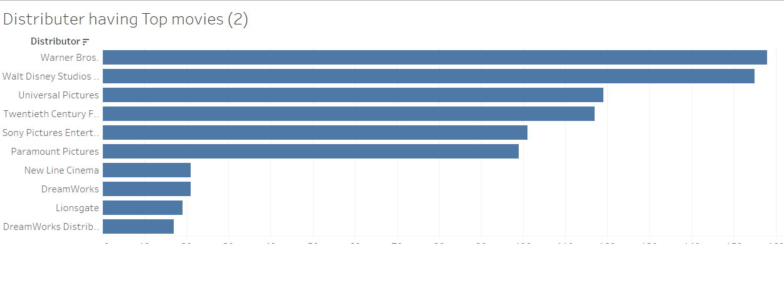
Analysis of Distributer having Top movies

Slide 5
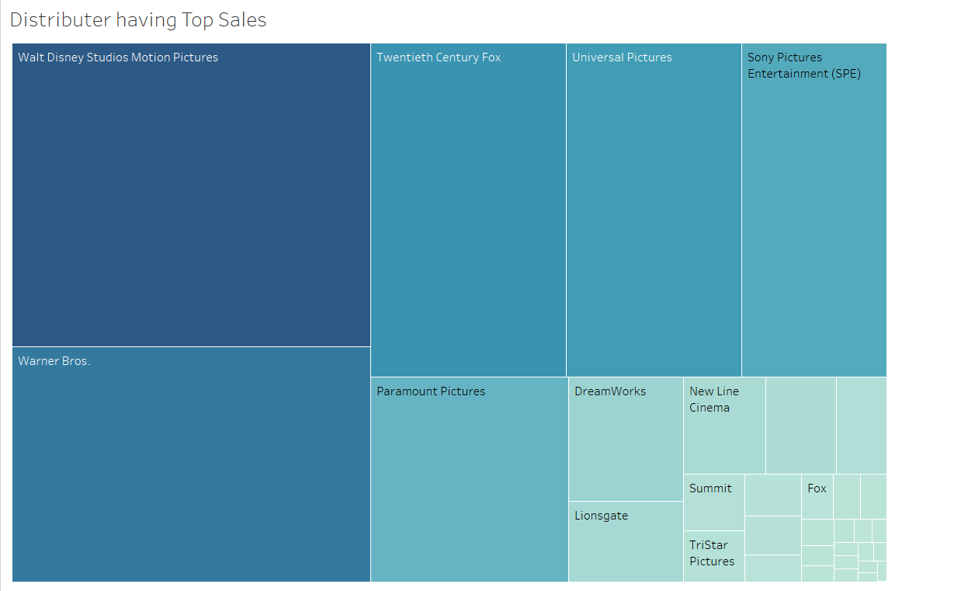
Analysis of Distributer having Top sales
In this section we have taken distributers from dimension and then apply Conditional filter and parameter on the sales so that we an easily see the top sales of Domestic, International and world wise, and in this section we have created tree map.

Slide 6
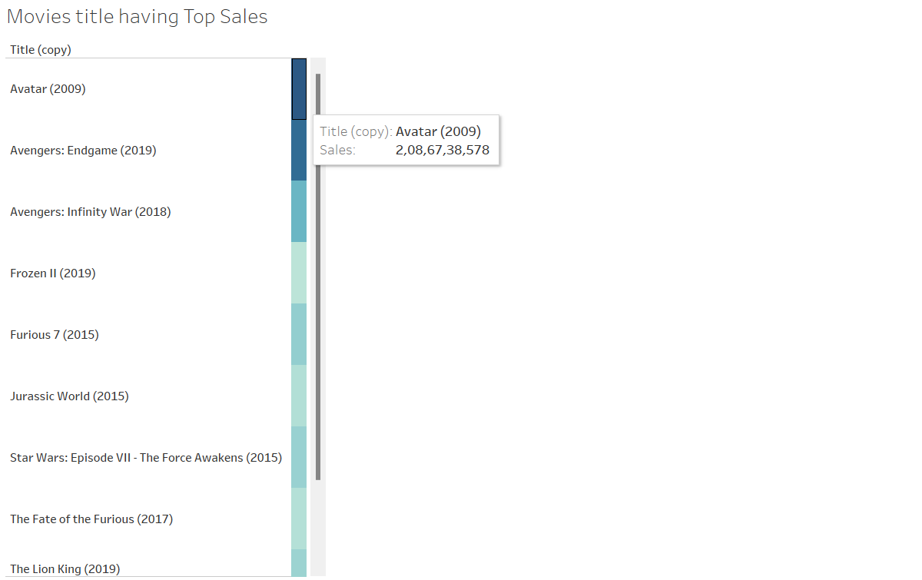
Analysis of Movies Title having Top sales

Slide 7
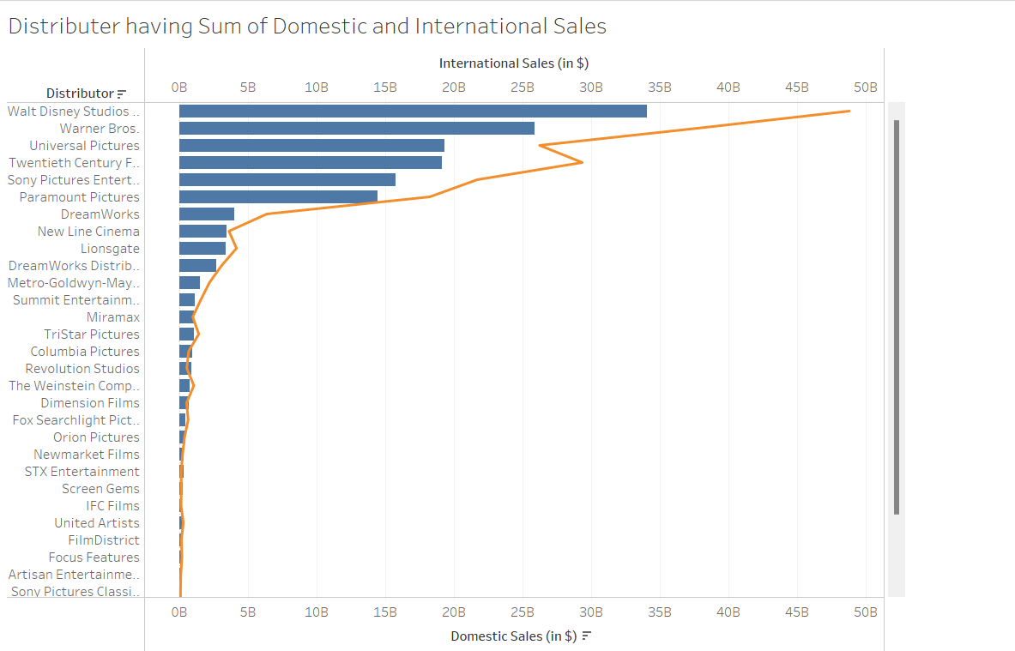
Distributer having sum of Domestic and International sales

Slide 8
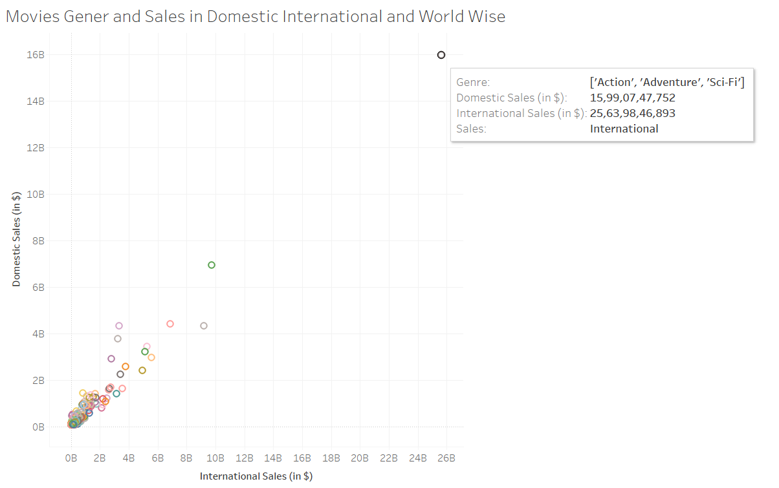
Movies, Gener and sales is in Domestic, International and World wise

Slide 9
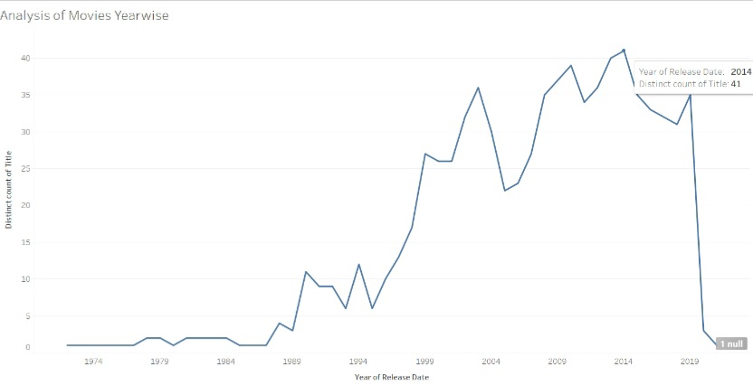
Analysis of Movies on the basis of Year

Slide 10
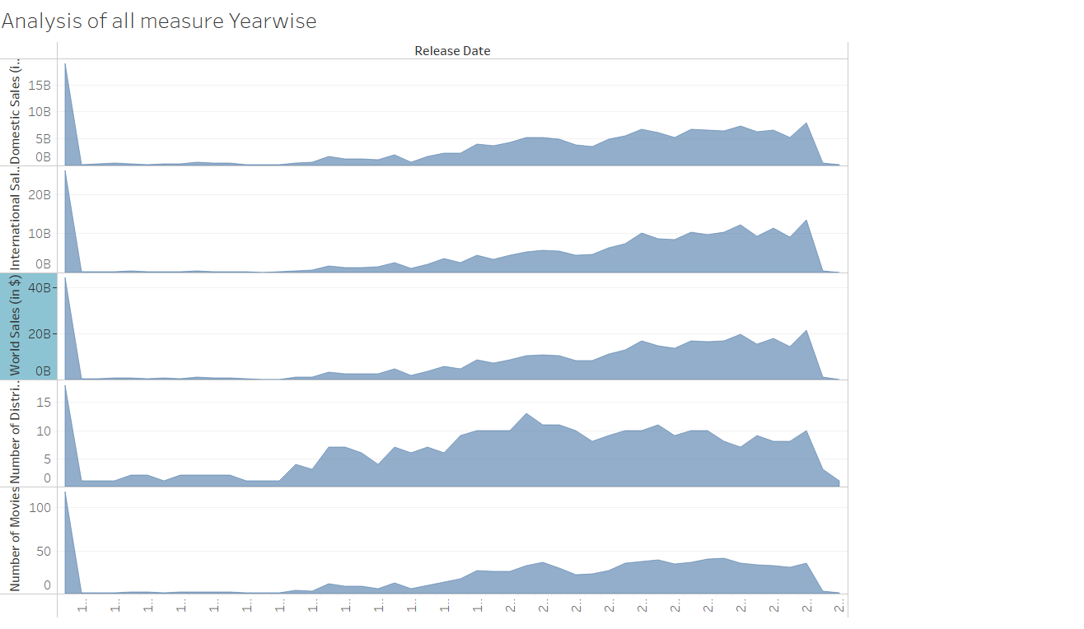
Analysis of all Measure in Data

Slide 11
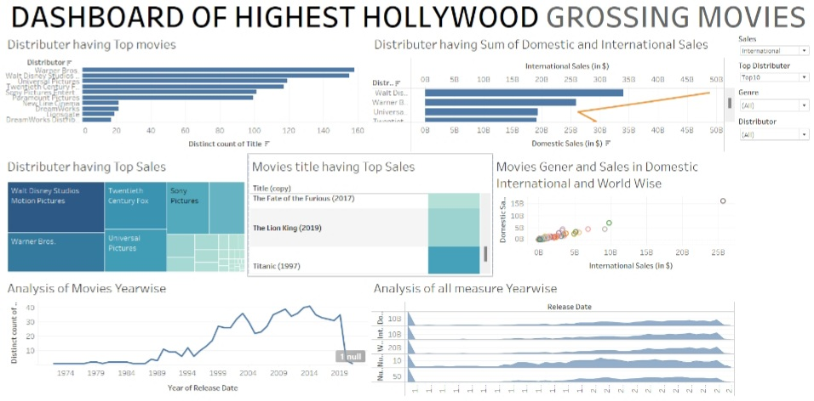
ANALYSIS DASHBOARD OF HIGHEST HOLLYWOOD GROSSING MOVIES

Slide 12
Conclusion

Slide 13
YOU CAN SEE ON THE FOLLOWING LINK
YOUTUBE LINK
https://www.youtube.com/watch?v=zRdjg_vc9lU
TABLEAU DASHBOARD LINK
https://public.tableau.com/app/profile/sumit.kumar5609/viz/TableauCapstonProject/Dashboard1?publish=yes

Slide 14
REFERENCE
https://www.kaggle.com/sanjeetsinghnaik/top-1000-highest-grossing-movies

Slide 15
THANK YOU.

